Slide 1

TITLE SLIDE: TSDS ODS 3.x Project
Updates
TSDS UPGRADE PROJECT
Overview and Key Concepts

Slide 2

COURSE AGENDA
GETTING STARTED
High Level Architecture
Key Concepts
Data Loading, Promotion, Validation
Knowledge Check
Training Activity
WRAP-UP
Key Takeaways, Resources, and Next Steps

Slide 3


GETTING STARTED
High Level Architecture

Slide 4
HIGH-LEVEL ARCHITECTURE
Data

Slide 5
HIGH-LEVEL ARCHITECTURE
Data
Landing Zone
Each LEA will be provided a local Individual Operational Data Store (IODS).
Source system vendors will publish data via API transactions at near real-time.

Slide 6
HIGH-LEVEL ARCHITECTURE
Application
LEAs will be able to view data loads and run validations on local IODS data.
Data

Slide 7
HIGH-LEVEL ARCHITECTURE
Data
Transition Zone
TEA will automatically retrieve data from the Landing Zone.
Data will be filtered to ensure only TSDS mandated data is loaded to the Transition Zone.
LEAs will promote and complete submissions as they do now.

Slide 8

HIGH-LEVEL ARCHITECTURE
Data
Data
TSDS Applications
The PEIMS and Core Collections applications are used to promote and finalize the TSDS data submissions.
The PEIMS and Core Collections Data Marts store the data that is promoted from the Transition Zone.
The Unique ID application is used to search and assign Unique IDs for students and staff.
These applications are not expected to change.

Slide 9
WHAT IS EXPECTED TO CHANGE?
eScholar Data Manager (eDM)
Delete Utility
Validation Tool, File Manager, and Batch Manager
Most validations downstream
Data Management Center (DMC)
Handle through API transactions
Level 1, Level 1.5, and Level 2 validations and filters
More validations at local level
CURRENT TSDS
TSDS UPGRADE

Slide 10

KEY CONCEPTS
Data Loading, Promotion, and Validation

Slide 11
KEY CHANGES TO DATA LOADING
There will no longer be a need for extracting and loading XML files.
There will be one stream of singular transactional data published from the local source systems into the IODS at near-real time via API transactions.
Data will be seamlessly updated in the IODS to reflect updates and corrections the LEA makes in their local source systems.

Slide 12
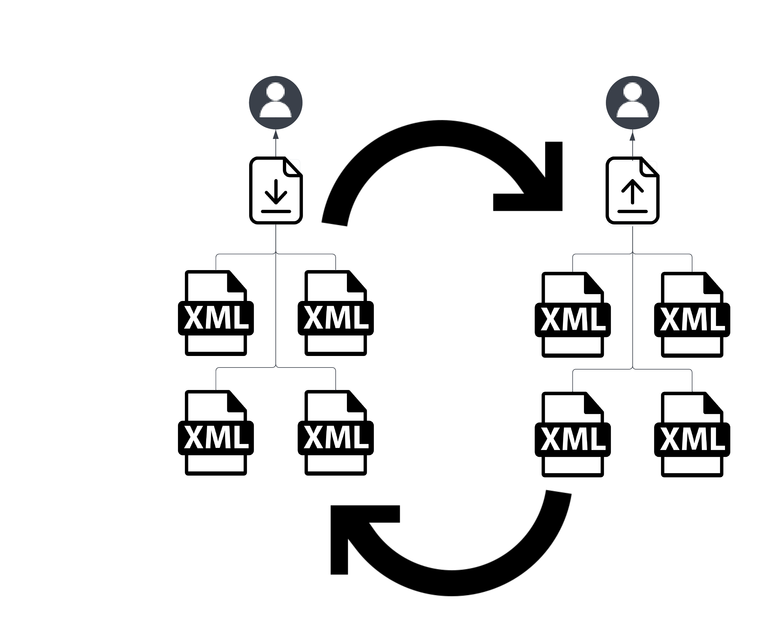



CHANGES TO DATA LOADING PROCESS
Currently XML files are manually extracted and loaded.
After the upgrade, data will be automatically loaded via API transactions.
Current ODS
IODS (Landing Zone)
Source System
Local Source System
The vendors will publish the singular transactional data from the local source systems to the LEA’s IODS via API transactions.
LEAs currently bulk load their data through XML files into the eDM.

Slide 13
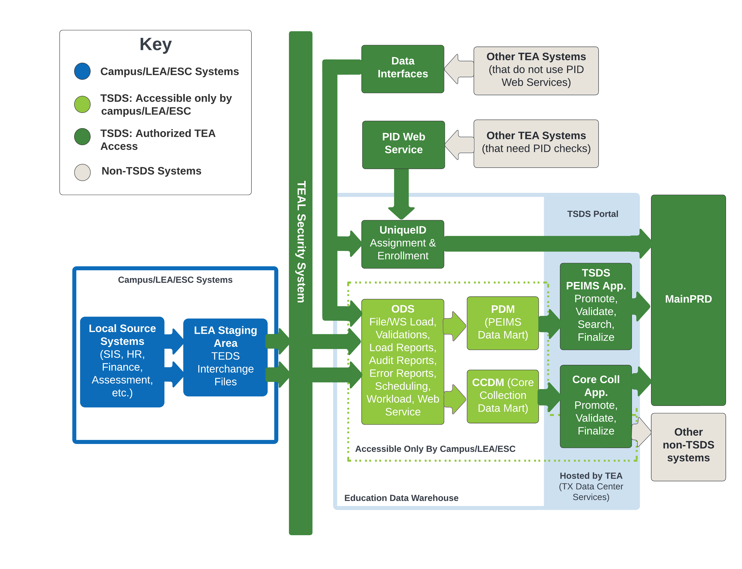

HOW DATA IS CURRENTLY LOADED
PEIMS
LEA Promotes
4*
TSDS
7*
Bulk transactional data via XML files
*4 and 7 refer to the number of individual collections for PEIMS and Core

Slide 14
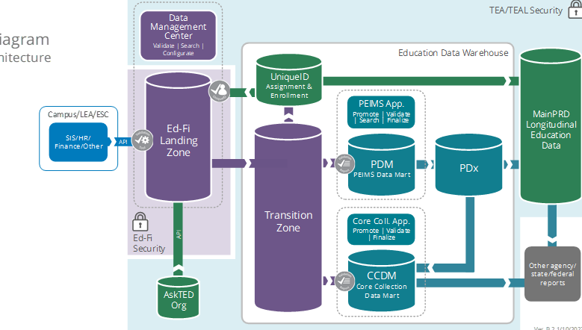
HOW DATA WILL BE LOADED
Data
Singular Transactional
Only State Reported Data
4
LEA Promotes
Singular transactional data via API transactions
7

Slide 15
HOW DATA WILL BE PROMOTED
The data submission deadlines will not change.
Data promotions, validations, completions in TSDS will continue to be a manual process.
Going forward all data (i.e., PEIMS and Core) will be loaded in one database as we do today with TSDS data for the Core Collections in the eDM.
  As a result, promotion logic and data field effective dates (i.e., begin/end dates) will be used to determine which data should be promoted for each collection.

Slide 16
BEGIN AND END DATES
In order to “effective date” some data elements, TEA will collect Begin Dates and End Dates. The TSDS system will determine for which collections date-sensitive data will be promoted based on the begin and end dates.
Begin date is the first instructional day upon which something is considered to take effect.
End date is the day after the last instructional day when something is considered to no longer be in effect.
Some data fields will require that the begin/end dates be updated yearly. i.e., Homeless Status
Other data fields do not require an end date unless the status changes. i.e., Emergent Bilingual Indicator

Slide 17
GENERAL PROMOTION LOGIC
TEA is developing promotion logic to promote data for the different data submissions that is not date specific.
  For PEIMS Summer, we collect attendance data for all students and the general promotion logic is to promote all students who are enrolled and in membership at any time during the school year.
  For Residential Facility Tracker, the general promotion logic is to promote the data for students who are enrolled AND are receiving special education services AND reside in a residential facility at any time during the school year.
A 9th grade student is economically disadvantaged and eligible for free and reduced lunch. A start date and an end date must be entered for these services. In addition, these dates will need to be updated each year.

Slide 18
BEGIN/END DATE EXAMPLE
How the begin and end dates can affect the data that is reported for different data collections.
  Mrs. Jones begins teaching 3rd grade at the LEA on August 15. Her StaffClassification is 087 (teacher) with a BeginDate (E3010) of YYYY-08-15.
  On October 3, Mrs. Jones leaves the LEA. The LEA entered an EndDate (E3020) of YYYY-10-03.
  On October 20, Mrs. Jones returns to the LEA to serve permanently as a substitute on an as-needed basis. Her StaffClassification is now 047 (substitute teacher) with a BeginDate (E3010) of YYYY-10-20.
A 9th grade student is economically disadvantaged and eligible for free and reduced lunch. A start date and an end date must be entered for these services. In addition, these dates will need to be updated each year.

Slide 19
LEVELS OF VALIDATIONS
LEVEL 1
Includes basic data integrity checks that occur during the process of loading data via API transactions into the Individual Operational Data Store (IODS) in the Landing Zone. Data that fails Level 1 validations does not enter the IODS.
LEVEL 1.5
Includes filters that prevent invalid or non-TSDS data from being loaded into TSDS. These filters include Unique ID checks, descriptor value checks, Do Not Report flag checks, and Course ID checks.
LEVEL 3
Business rules that are executed in TSDS. Level 3 validations contain all Level 2 validations, plus any additional validations required for the TSDS submissions. Fatal errors prevent TSDS submissions from being completed or finalized.
LEVEL 2
Business rules that are executed on the data destined for TSDS. Fatal, Special Warning, and Warning validation errors do not prevent data from being loaded to TSDS.
Prevents data from loading to IODS
Prevents data from loading to Transition Zone
Does not prevent loading to TSDS.
Fatals prevent from completing submission

Slide 20
LEVEL 1 VALIDATIONS
Data
Level 1
API errors that prevent data from being loaded to the IODS in the Landing Zone.
These must be resolved by the source system vendor.

Slide 21
LEVEL 1.5 FILTERS
Data
LEVEL 1.5
Filter checks performed in the IODS in the Landing Zone that prevent data from being loaded to TSDS.
Checks the values of course IDs, descriptor values, Unique IDs, and data flagged as “Do Not Report”.

Slide 22
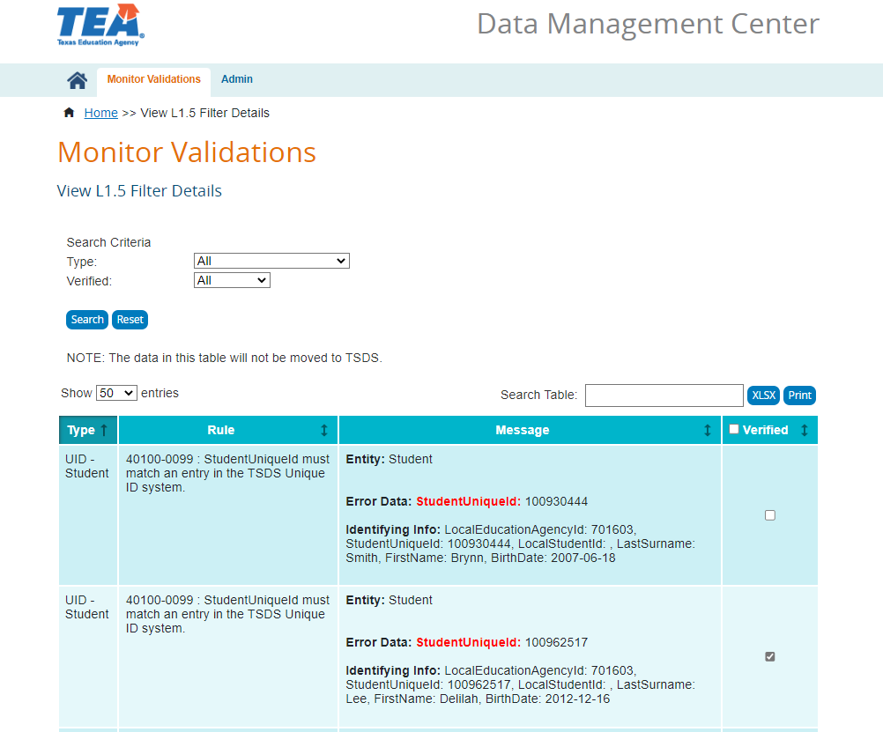



LEVEL 1.5 FILTER EXAMPLES
TEAL ROLE
SEARCH BY TYPE
Course ID, Descriptor Value, Do Not Report, Unique ID
DMC LEA Data Monitor
DMC LEA Data Monitor
DMC L1.5 Filters Access
VERIFY RESULT
A result can be “verified” to assist future analysis

Slide 23
LEVEL 2 VALIDATIONS
Data
LEVEL 2
Business rule validation checks that are run against the data prior to promoting to PEIMS or Core data mart.
These include Fatals, Special Warnings, and Warnings. Validation errors do not prevent the data from being loaded to TSDS.
Users will need to resolve the Fatal errors prior to completing their TSDS data submissions.

Slide 24
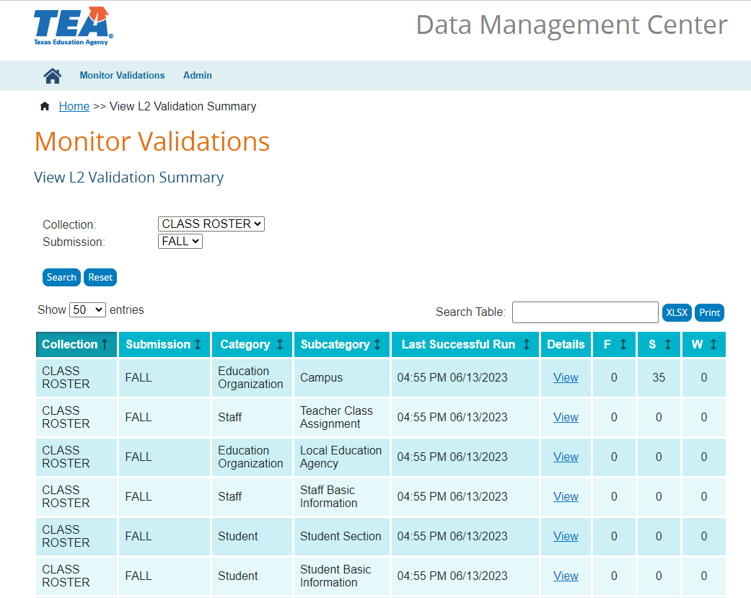
LEVEL 2 VALIDATION EXAMPLES
TEAL ROLE
RUN BY COLLECTION
Select the TSDS Collection/ Submission to validate
DMC LEA L2 Validations
DMC LEA Data Monitor
Class Roster Access
SEVERITY LEVEL
View Fatal, Special Warning, and Warning
counts and results

Slide 25
VIEWING LEVEL 1.5 AND LEVEL 2
VIEW IN DMC
Level 1.5 and Level 2 results are displayed in the DMC application.

Slide 26
LEVEL 3 VALIDATIONS
Data
Data
LEVEL 3
Business rule validation checks that are run against the data after promoting to PEIMS or Core data mart. Will include some validations that could not be run at Level 2.
These include Fatals, Special Warnings, and Warnings.
Users will need to resolve the Fatal errors prior to completing their TSDS data submissions.
Data

Slide 27
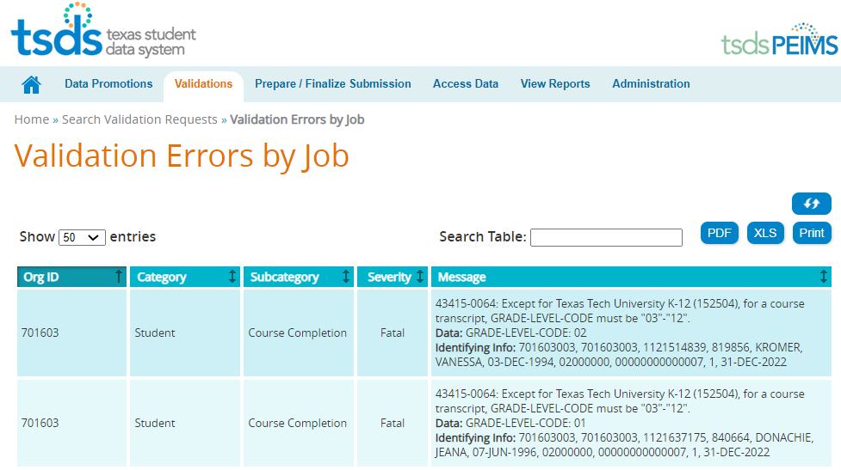
LEVEL 3 VALIDATION EXAMPLES
Notes:
NOTE
The data being filtered out does not indicate that the data is wright or wrong.
The LEA can move local data into their IODS that should is not appropriate to move to TSDS.
The IODS is the LEA’s own separate operational data store that houses all the data it loads to the IODS in the Landing Zone for TSDS data and/or local use data.
The LEA will need to check all of their results that are generated by Level 1.5 filters and either verify the data should not move to TSDS or correct the data so that it can move to TSDS.

Slide 28

WRAP UP
Key Takeaways, Resources, and Next Steps

Slide 29

KEY TAKEAWAYS
This is a system upgrade, not a system replacement.
Vendors will send only API transactions XML will no longer be accepted.
TSDS will utilize “effective dating” though begin and end dates to ensure the proper data is promoted.
There are various levels of validation to include: Level 1, Level 1.5, Level 2, and Level 3.
AVAILABLE RESOURCES
    TSDS Upgrade Project
    Description and information on the project
    Training Materials
    Step-by-Step Guides
    How-To Videos

Slide 30
NEXT STEPS
Plan to take additional trainings on:
  TEDS
  DMC
  TEAL Roles
  Administrative Features
  Level 1.5 Filters
  Descriptor Mapping
  Level 2 Validations
REMEMBER: THIS PROJECT IS A TSDS UPGRADE!
Much of what you know will stay the same with some upgrades to make TSDS even better.

Slide 31

TITLE SLIDE: TSDS ODS 3.x Project
Updates
QUESTIONS

